Slide 1
HTTP/1.1 200 OK
Server: skillsmatter.com
Content-Type: application/x-slides-and-code-and-crap-jokes
Cache-Control: remember, share, tell-your-friends
Content-Length: about-1½-hours
Date: Tue, 05 Apr 2011 18:30:00 BST
Set-Cookie: flavour=chocolate_chip; path=/;
X-Subject: JavaScript
X-Powered-By: monmouth-coffee-and-80s-music
X-Speaker-Name: Dylan Beattie
X-Speaker-Email: dylan@dylanbeattie.net
#X-Speaker-Twitter: @dylanbeattie
X-Speaker-Website: www.dylanbeattie.net

Slide 2
So…
You think you know Javascript?
Notes:
Javascript is to modern software what the electric guitar is to modern music. Versatile, accessible, purists hate it, beginners love it, but it’s had such a profound and widespread impact that you really can’t ignore it.
It’s been called the “world’s most misunderstood programming language”, and tonight I’m hoping to clear up some of that misunderstanding, to explore how – and why – JS has ended up being so misunderstood, and to show you some of the amazing work that people are doing with this remarkable language.
First, though we’re going to play a game – make sure everybody’s awake. It’s time to play… NAME THAT LANGUAGE!

Slide 3
Name That Language – Round 1
int Factorial(int n) { if (n < 2) return(1); return n * Factorial(n - 1); }
Notes:
This is syntactically valid in C#, Java, C and C++ - so if anyone guesses, I can make sure they guess wrong ☺

Slide 4
Name That Language – Round 2
(define (factorial n) (if (< n 2) (1) (* n (factorial (- n 1))))
Notes:
This is Scheme – from whence Javascript took static scoping and its functional programming style.

Slide 5
Name That Language – Round 3
int Factorial(int n) { if (n < 2) return(1); return n * Factorial(n - 1); }
Notes:
Also C/C++/Java/C#

Slide 6
Name That Language – Round 4
PROC factorial = (INT upb n)LONG LONG INT:( LONG LONG INT z := 1; FOR n TO upb n DO z *:= n OD; z );
Notes:
This is Algol-60 – a truly remarkable language, and the first language to use lexical scoping.

Slide 7
Name That Language – Round 5
int Factorial(int n) { if (n < 2) return(1); return n * Factorial(n - 1); }
Notes:
Another C#/C/C++ slide. This is getting silly now.

Slide 8
Name That Language – Round 6
function Factorial(n) { if (n < 2) return(1); return n * Factorial(n - 1); }
Notes:
Javascript (yay!)

Slide 9
Name That Language – Round 7
Number extend [ my_factorial [ self < 0 ifTrue: [ self error: 'not defined' ]. self isZero ifTrue: [ ^1 ]. ^self * ((self - 1) my_factorial) ] ]
Notes:
Smalltalk – where EVERYTHING is an object.

Slide 10
Name That Language – Round 8
Number.prototype.factorial = function() {
if (this < 2) return(1);
return(this * ((this - 1).factorial()));
}
Notes:
Javascript – again, but this time OO javascript based on Smalltalk’s object system.

Slide 11
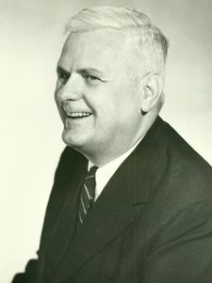
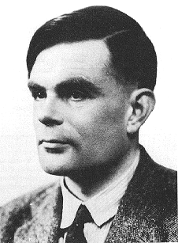
λ
Notes:
1936 – Princeton. Picture a scene something like Indiana Jones’ office in Raiders of the Lost Ark – wood-panelled studies, Gothic buildings and leafy campus lawns. Computers don’t exist yet and computability is still somewhere between mathematics and philosophy. Following long correspondence with Kurt Godel on the theory of computability, the American mathematician Alonzo Church creates a formal notation for studying the definition and application of functions. Church chooses the greek letter Lambda to represent anonymous functions in his notation, and his work becomes known as the lambda calculus.
If you’ve ever wondered why anonymous functions in .NET and Python are known as “lambdas” – that’s why.
Church went on to supervise Alan Turing’s PhD at Princeton; and together, their work has become known as the “Church-Turing thesis” – one of the most important theorems in computer science - which basically states that everything computable is computable by a Turing machine.

Slide 12
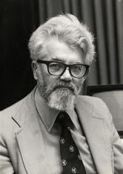
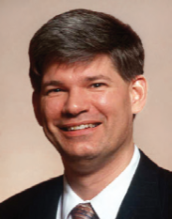
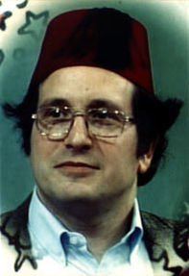
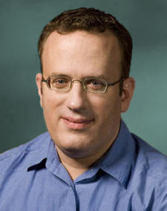
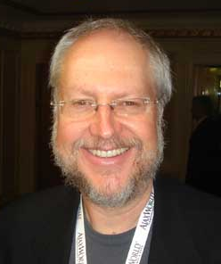

( )
Notes:
Twenty-odd years later, this man - John McCarthy - joins MIT and starts the MIT AI Project. In 1960, he John McCarthy publishes his design for a new language, based on lists of symbols – he calls the language “Lisp”, short for “list processing”, and one of the key features of his theoretical language design is a routine called eval.
One of his grad students, Steve Russell, realizes that the eval function, as well as being part of the language design, would actually work as a Lisp interpreter – and implements it, in machine code on an IBM 704. Suddenly Lisp exists. Steve Russell goes on to make computer history by writing Spacewar! for the PDP10 minicomputer – one of the first computer games ever created – and Lisp proves so successful that it’s still in use today.

Slide 13
() + λ
Notes:
The next step on the road to Javascript takes place around 1975. Guy L Steele – famous as the GLS who edited the Hackers Jargon File for most of the 1980s – and his colleague Gerald Jay Sussman set out to create a “minimalist dialect” of Lisp (c.f. Common Lisp). In a series of publications known as the “lambda papers”, they develop a new dialect of Lisp, very closely based on Alonzo Church’s original lambda calculus. Originally a derivation of an earlier programming language called Planner – they dubbed it Schemer, but the PDP-10 had a 6-character limit on the ITS file-system, hence SCHEME.
Scheme was the first dialect of Lisp to choose lexical or static scope (borrowed from Algol) – which we’ll look at in a moment.

Slide 14
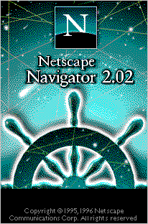
Notes:
The next milestone is the bit no-one’s ever heard of – an “extreme object-oriented language” called Self, developed at Xerox Parc in the 1980s. Self is notable because it was the first language to introduce prototyped inheritance – something we’ll be discussing quite a lot in the next hour or so – but other than that, the language is so obscure I couldn’t even find a factorial example to use in the Name That Language game earlier.
Anyway. Let’s fast-forward to April 1995. Netscape are gearing up for their big dot-com-bubble IPO, and someone decides their new browser should have some sort of programming language in it. They call Brendan Eich, an engineer who cut his teeth writing operating systems for Silicon Graphics, and ask if he wants to come over and “implement Scheme in their browser”
(http://brendaneich.com/tag/history/) – sounds weird now, but at the time there were bespoke macro languages, and there was Emacs and AutoLISP.
Eich ends up – like all of us have – stuck between a wealth of industry knowledge and best practise on one hand, and crazy marketing pressure on the other. Java was huge, Netscape were courting Sun to ship Java in their browser, and Bill Joy (founder of Sun Microsystems) grokked the idea of a light-weight scripting language as a companion to full-blown compiled Java applets. Netscape upper management said the language “must look like Java” and there was a general consensus that it had to run in the browser, in source form – no linkers, no compilers. He’s said "JS had to “look like Java” only less so, be Java’s dumb kid brother or boy-hostage sidekick. Plus, I had to be done in ten days or something worse than JS would have happened“ (http://en.wikipedia.org/wiki/Brendan_Eich)
So Eich cherry-picks. He borrows his syntax from Java. From an obscure OO language called Self, he borrows something called prototyped inheritance. He borrows the “function” keyword from Awk, regular expression literals from Perl, and pretty much everything else from Scheme. And it worked. Kinda. Eich said in 2008 that “he still thinks of JS as the quickie love-child of C and Self; the part that is good is not original, and the part that is original is not good” (http://brendaneich.com/tag/history/) but as we’ll see tonight, it doesn’t seem to have done JS’ popularity any harm.
August 11, 1995 – Alonzo Church dies in Ohio aged 92.
September 1995 – “LiveScript” makes its debut in Netscape Navigator 2.0 beta, the same month that Larry Page joins Sergey Brin at Stanford.
December 4th, 1995 – Livescript officially renamed to Javascript, confusing everybody.
March 1996 – official release of Netscape 2.0 and the first release of Javascript.

Slide 15

Notes:
That summer, Microsoft bring out Internet Explorer 3.0, which supports almost everything… except the document.images array. Hands up anyone who was writing Javascript in 1996. What were you doing with it? Fancy image roll-overs? Yeah, me too.
Interesting to note that in IIS 3.0 – JScript on the server, which (along with Netscape’s LiveWire server) meant there were two competing implementations of server-side Javascript as far back as 1997.
Netscape could probably have sued – or *something* - but instead, they decided to make their language an open standard.
JavaScript submitted to ECMA in Nov 1996, concerned that standardizard (driven by document.images lack of support in IE3) was necessary for widespread adoption
ECMA-262 v1 adopted in June 1997, and in Oct 1997 – IE 4 includes JScript 3, the first non-Netscape implementation of ECMA 262

Slide 16
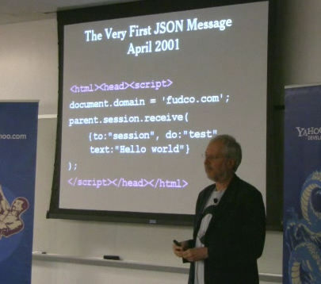
Notes:
1999 – IE5 introduces the XMLHTTP ActiveX control, but nobody notices because it’s ActiveX, it’s IE only, and no-one’s really doing anything much with it.
2000 – Outlook Web Access
2001 – the first JSON message.
Doug Crockford (Yahoo) “discovered” JSON in 2001
He says he’s since discovered someone at Netscape was using JS array literals for communication as early as 1996.
JSON – originally going to be called “jizmal” – the JavaScript Message Language
- but there was already the Java Speech Markup Language
- so they renamed it JSON
he says he didn’t invent it; he discovered it, named it and gave it a domain –
2002 – Douglas Crockford launches JSON.org
2003 (?) – Google Suggest – I can remember thinking “wow…”
2004 April 1st – Google announce GMail (invitation-only beta) and everyone assumes a gigabyte of free webmail is an April Fool’s joke.
2005 – (Feb 8th) Google Maps launches
Feb 18th – Jesse James Garrett coins the term Ajax (Asynchronous JavaScript + XML) to describe the new approach to web apps demonstrated by Google Suggest and Google Maps
June 2005 – Apple open-source WebKit
Aug 2005 – Doug Crockford joins Yahoo as Javascript Architect
Dec 2005 – Yahoo! begins offering JSON support for web services.
We have technology, we have cool names, we have killer apps, and the future is so bright we’re all wearing shades…

Slide 17



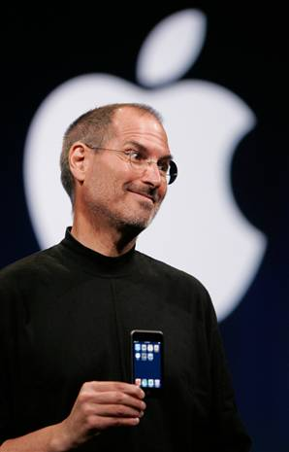
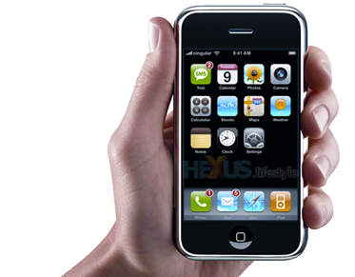
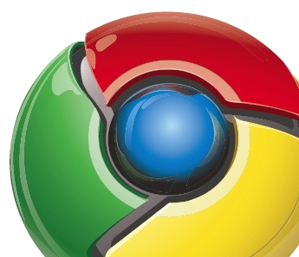
Notes:
March 21st, 2006 – Jack Dorsey tweets “Just setting up my twttr”
August 2006 – John Resig launches jQuery 1.0
John Resig is to Javascript what Jimi Hendrix was to the electric guitar – he did something singularly amazing that just wouldn't have been possible using anything else.
January 29th, 2007 – Apple announces the iPhone
March 2007 – Twitter “o wns” SxSW festival
June 2007 – iPhone goes on sale
November 5th, 2007 – Open Handset Alliance announce Android smartphone OS based on Linux Kernel 2.6
July 11, 2008 – iPhone 3GS
September 2008 – Google release Chrome beta
February 2009 – Ryah Dahl announces a new server project based on the V8 Javascript engine
March 2009 – ServerJS API 0.1
August 2009 – ServerJS renamed to CommonJS
NodeJS presented at JSConf
Jan 2010
Open source IronJS project announced – a full .NET implementation of Javascript written on top of the DLR using F#
Google launch the Nexus One handset
April 2010 – Steve Jobs famous “Thoughts on Flash”
May 2010 – Google announce the “Chrome Web Store”

Slide 18
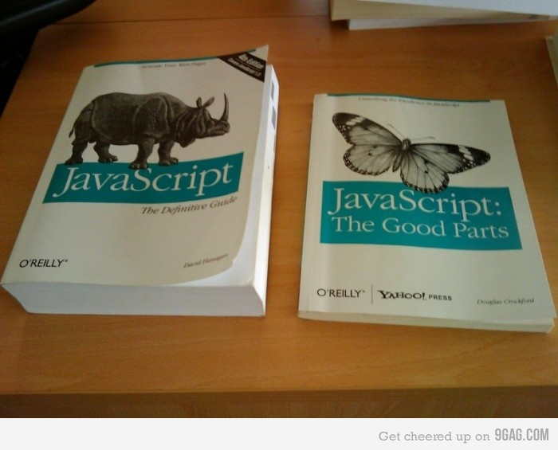
Notes:
Regex literals from Perl
Prototyped inheritance from self
Curly braces from Javascript
Everything else from Scheme
This photograph is not fair. But it made me laugh. Plus, the one on the left is full of browser DOM shit.

Slide 19
Functions
function addCheese(food) {
return(food + “ with cheese”);
}
function addBacon(food) {
return(food + “ with bacon”);
}
function combine(f1, f2) {
return(function(x) { f1(f2(x)) });
}
var makeAwesome = combine(addCheese, addBacon);
alert(makeAwesome(“ice-cream”));

Slide 20
Prototyped inheritance
var Hero = function(name, alias) {
this.name = name;
this.alias = alias;
}
var superman = new Hero(“Superman”, “Clark Kent”);
superman.cape = “red”;
superman.fly = function() {
return(“Faster than a speeding bullet!”);
}
Notes:
In Self, and other prototype-based languages, the duality between classes and object instances is eliminated.
In classical inheritance, when you pass someone an instance of vehicle, the compiler refers to the class declaration to see what it can do.
In prototyped inheritance, every instance keeps a REFERENCE to its originating class, but that’s just a loose object reference. Objects are disconnected from their definitions.

Slide 21
Dynamic Objects

Slide 22
Quote Marks
Either one is fine.
Same as in HTML.
var html = '<a href="http://www.google.com/">Google</a>';
VERY useful.

Slide 23
Object Literals
var bucket = {};
bucket[0] = "A thing";
bucket.snack = "steak sandwich!";
bucket['booze'] = "gin and tonic";

Slide 24
regex literals

Slide 25
exceptions

Slide 26
closures and callbacks

Slide 27
Javascript: The Gotchas

Slide 28
Scope and Hoisting
var alerts = []; for(var i = 0; i < 3; i++) { alerts.push(function() { document.write(i + ', '); }); } for (var j = 0; j < 3; j++) { (alerts[j])(); } for (var i = 0; i < 3; i++) { (alerts[i])(); }

Slide 29
Scope and Hoisting
var alerts = [];
var i, j;
for(i = 0; i < 3; i++) { alerts.push(function() { document.write(i + ', '); });
}
for (j = 0; j < 3; j++) { alerts[j]();
}
for (i = 0; i < 3; i++) {
alerts[i]();
}

Slide 30
"truthy" and "falsy"
False Things:
The empty string
Zero
NaN
null
([] == true)
True Things:
everything else
([])
([] == false)

Slide 31
this and event handlers
function binding
Notes:
When you're assigning event handlers, you are NOT saying "when I click this button, instantiate a new Controller object and run the Click() method on it" You are saying "there is a block of code that happens to be on that Controller object, and I want you to use that code as your click handler"
"this" does not mean "the object that defined this behaviour", it means "the object that INVOKED this behaviour"
So when you assign a code to a button's click event, when the code runs, 'this' refers to the button – NOT to the controller or object that defines it.

Slide 32
Arrays that aren’t really arrays
array.length – the highest integer index plus one

Slide 33
type coercion
Notes:
Be careful.
Dates – all date/times are true EXCEPT midnight on January 1st, 1970. As someone said who was there "It was midnight, New Years Eve, the dawn of a new decade, and there was optimism everywhere; everyone thought Vietnam was over, Nixon was honest, and we'd all be living on the moon by 2001. Looking back on it – it *was* false"
"false" is true. "0" is true.
"5" + 3 = 53
"5" – 3 = 2

Slide 34
Javascript: The Missing Pieces
IO
Networking
Everything Else
Notes:
Javascript defines NOTHING. The core language has no networking, no I/O, no filesystem access – in fact, it doesn't even define any extension mechanism for adding these things.
Making Javascript talk to the rest of the world is ALL about the host – the engine that's actually running the code.
When the engine is a browser, Javascript gets full access to the DOM, and to various things like XMLHttpRequest that are exposed by the browser's Javascript runtime. You know that slide earlier about "Javscript: The Complete Guide" vs "Javascript: The Good Parts" ? That's because the Complete GUide actually covers every DOM element, event and attribute, and documents their cross-browser implementations and compability issues.

Slide 35
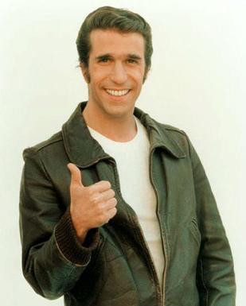

Slide 36
CommonJS
how to use requires

Slide 37
JavaScript Pop Quiz #1
var alerts = [];
for(var x = 0; x < 3; x++) {
alerts.push(function() { document.write(x + ', '); });
}
for (var y = 0; y < 3; y++) { (alerts[y])(); }
for (var x = 0; x < 3; x++) { (alerts[x])(); }

Slide 38
Knockout

Slide 39
JavaScript Pop Quiz #2
function GetGuru() { return {
name = 'Jon Skeet',
job = 'Guru'
};
}
function GetGuru()
{
return
{
name = 'Jon Skeet',
job = 'Guru'
};
}

Slide 40
Javascript Pop Quiz #3
try { return(true);
} finally { return(false);
}

Slide 41
Layout Engines (Tempo)

Slide 42
A Simple Server in NodeJS

Slide 43
Manifests

Slide 44
Web Sockets

Slide 45
HTTP/1.1 307 Redirect
Location: http://www.theslaughteredlambpub.com/ Content-Type: refreshment/x-beer-and-more-crap-jokes Content-Length: until-they-throw-us-out X-Thanks-To: Steve Sanderson Tom Scott Ian Cooper SkillsMatter
X-More-Info-At http://www.dylanbeattie.net/javascript/ X-Speaker-Name: Dylan Beattie X-Speaker-Email: dylan@dylanbeattie.net X-Speaker-Twitter: @dylanbeattie

